Slide 1


Towards General-Purpose Robots via Large Language Models
Xu Yin
SGVR Lab, School of Computing
KAIST
Scalable Graphics, Vision & Robotics Lab

Slide 2
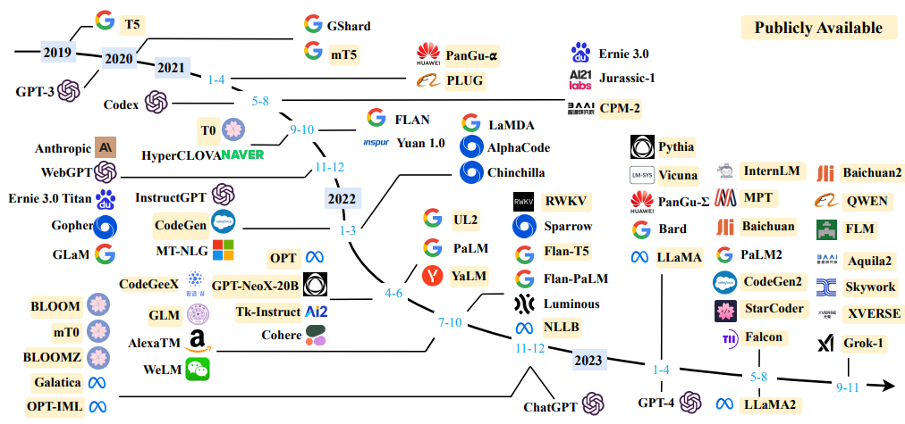
LLMs are changing our world:
[1] Zhao, Wayne Xin, et al. "A survey of large language models." arXiv preprint arXiv:2303.18223 1.2 (2023).

Slide 3
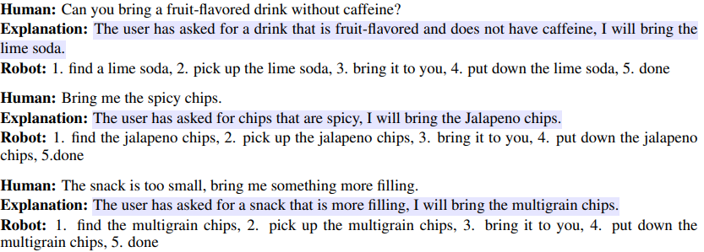
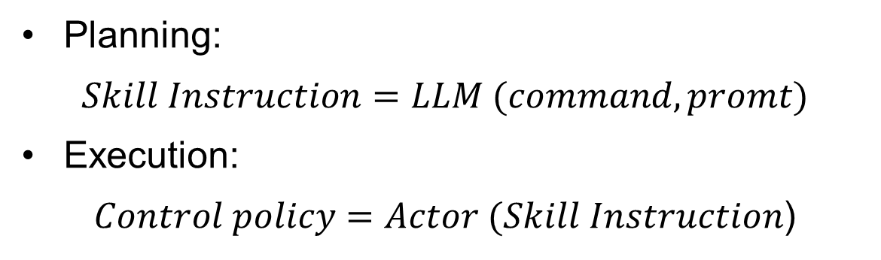
Robot: decision-making and Planning
Planning:
$$Skill Instruction=LLM (command,promt)$$
Execution:
$Control policy=Actor (Skill Instruction$)
[2] Brohan, Anthony, et al. "Do as i can, not as i say: Grounding language in robotic affordances." Conference on robot learning. PMLR, 2023.

Slide 4
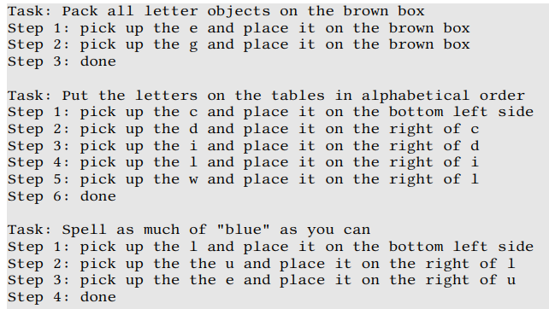
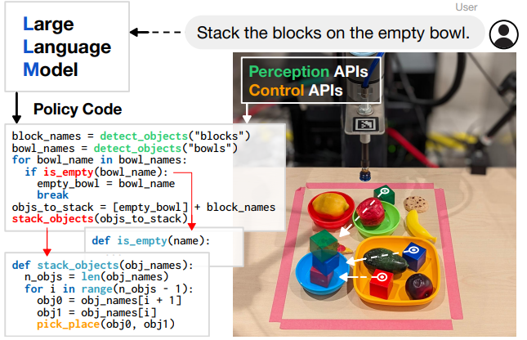
Prompt example
Instruction-based
Code-based
[3] Huang, Wenlong, et al. "Grounded decoding: Guiding text generation with grounded models for embodied agents." Advances in Neural Information Processing Systems 36 (2023).
[4] Liang, Jacky, et al. "Code as policies: Language model programs for embodied control." 2023 IEEE International Conference on Robotics and Automation (ICRA). IEEE, 2023.

Slide 5
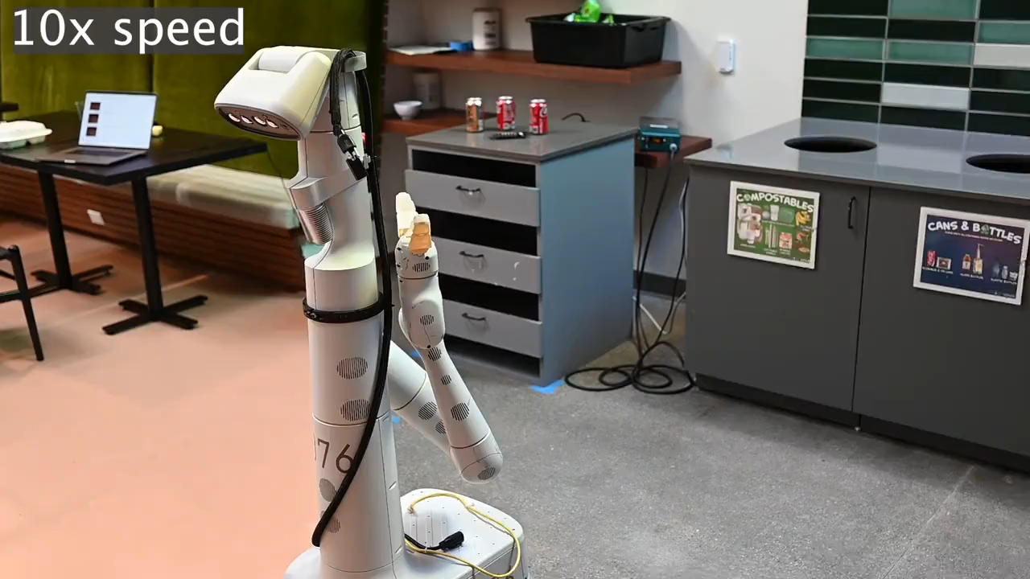

Slide 6
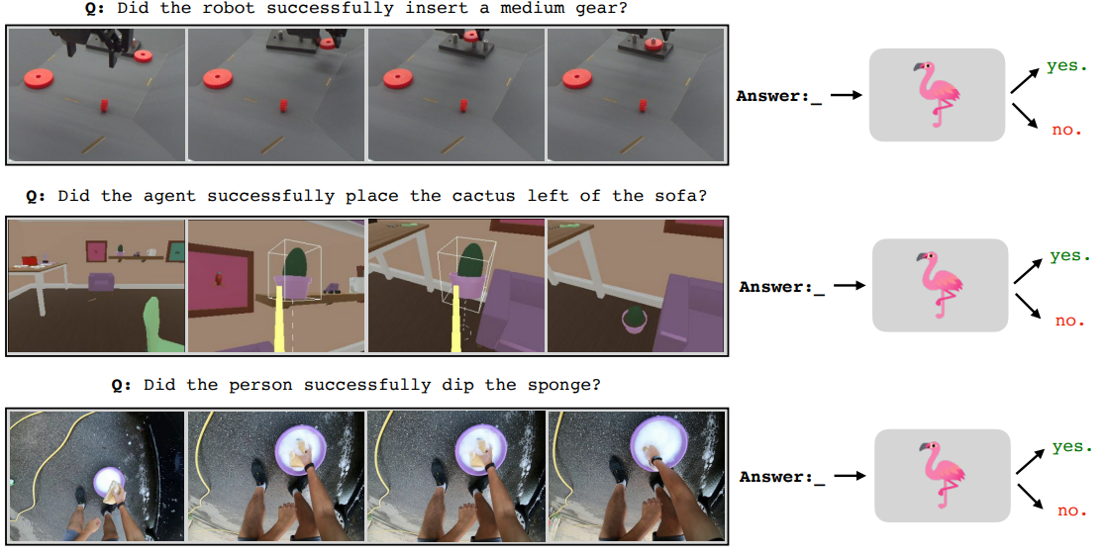
Bridge the modality: Visual Language Models
“integrates and learns from both visual data and language data to perform cross-modal tasks”
[5] Du, Yuqing, et al. "Vision-language models as success detectors." arXiv preprint arXiv:2303.07280 (2023).

Slide 7
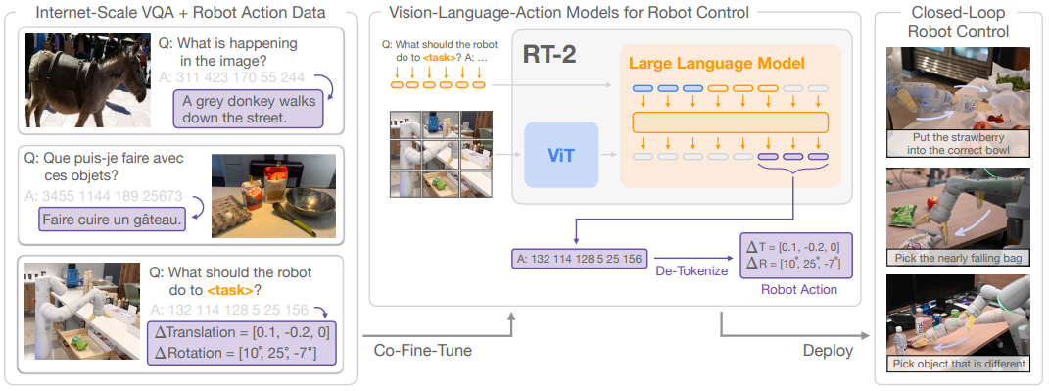
VLM → Visual-Language-Action Models
“map visual-text input to robot actions”
[6] Brohan, Anthony, et al. "Rt-2: Vision-language-action models transfer web knowledge to robotic control." arXiv preprint arXiv:2307.15818 (2023).

Slide 8
LangPert: Detecting and Handling Task-level Perturbations for Robust Object Rearrangement

